Slide 1
Obama Dataset
 | # of Videos | Video Length (s) | Total # of Frames
Pristine Obama Videos (Train Positive) | 80 | 7118 | 207994
Pristine Others’ Videos (Train Negative) | 500 | 6335 | 184116
Pristine Obama Videos (Test Positive) | 76 | 6720 | 196541
Generated Face-swap Video (Test Negative) | 117 | 2791 | 283916
Impersonator Video (Test Negative) | 2 | 417 | 12707
Other Politicians’ Video (Test Negative) | 50 | 15561 | 456449
Trump
 | # of Videos | Video Length (s) | Total # of Frames
Pristine Trump Videos (Train Positive) | 14 | 1207 | 35257
Pristine Others’ Videos (Train Negative) | 197 | 3681 | 101819
Pristine Obama Videos (Test Positive) | 12 | 1027 | 23838
Generated Face-swap Video (Test Negative) | 73 | 1184 | 121328
Other Politicians’ Video (Test Negative) | 50 | 15561 | 456449

Slide 2
TP Frame Length k = 100 Frame, Overlap m = 10 Frame
 | Trump | Obama
Location of the head wrt camera | 0.676117 | 0.52
Head rotation | 0.819682 | 0.465786
Lip gap/width | 0.984704 | 0.992473
Eye gaze direction | 0.682071 | 0.892383
Eye blink | 0.703402 | 0.875203
5 Features Combined | 0.658025 | 0.30054

Slide 3
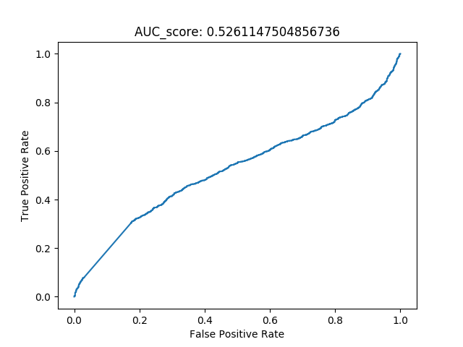
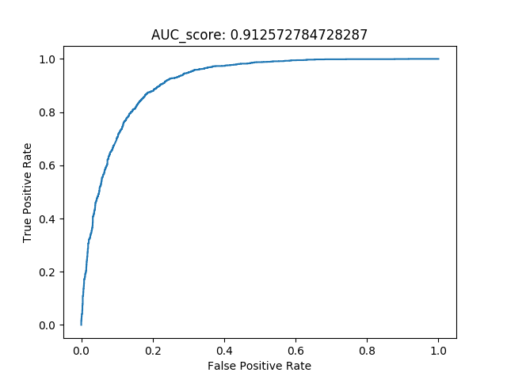
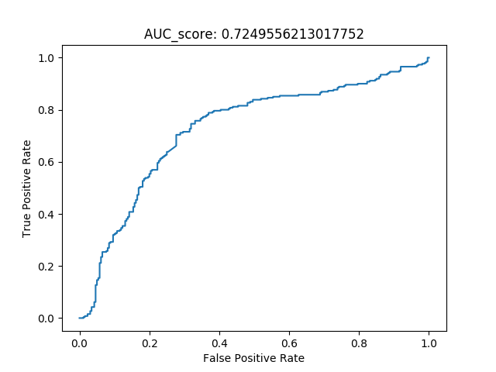
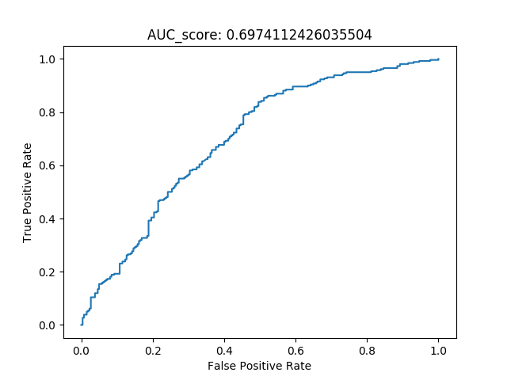
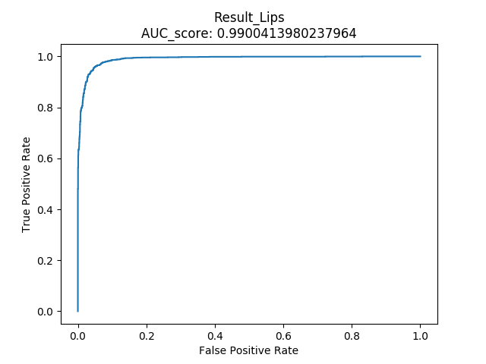
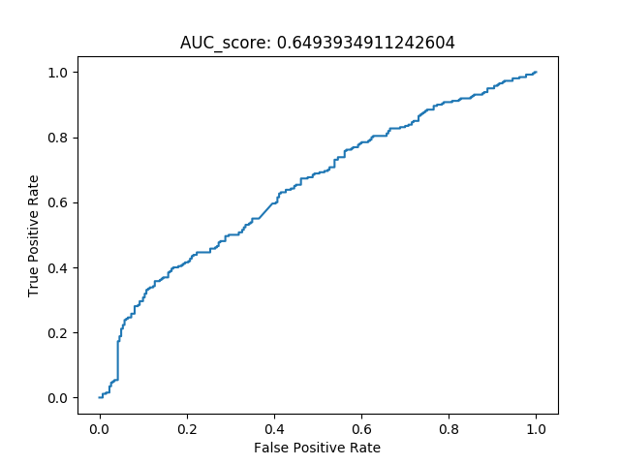
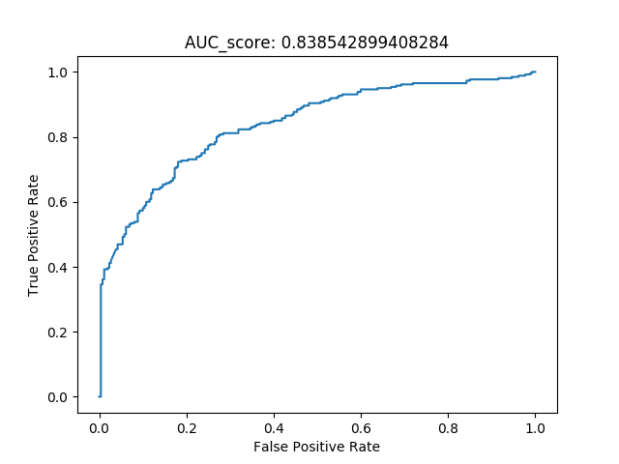
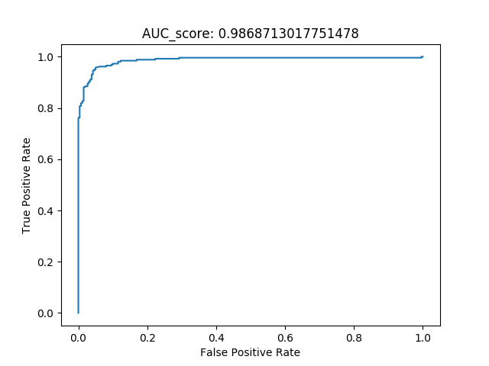
TP Sequence = 100 Frame, Overlap = 10 Frame
Head wrt. Camera | Head Rotation | Gaze | Blink | Lips (Gap/Width)
Obama
Trump

Slide 4
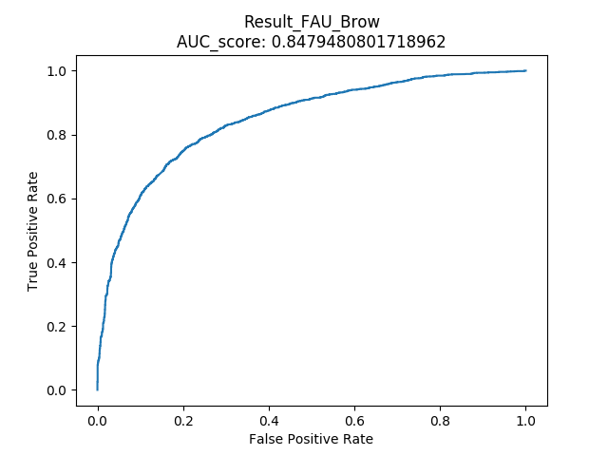
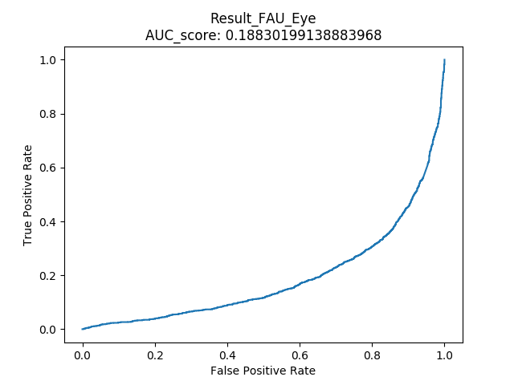
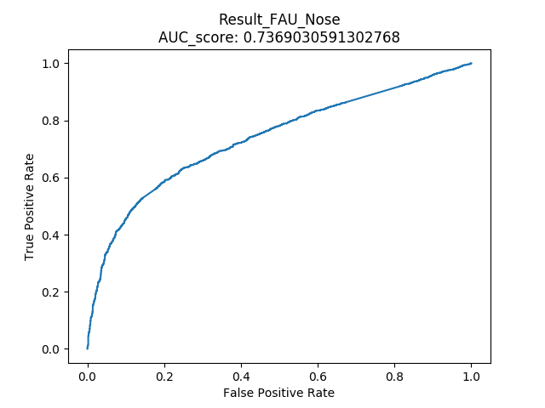
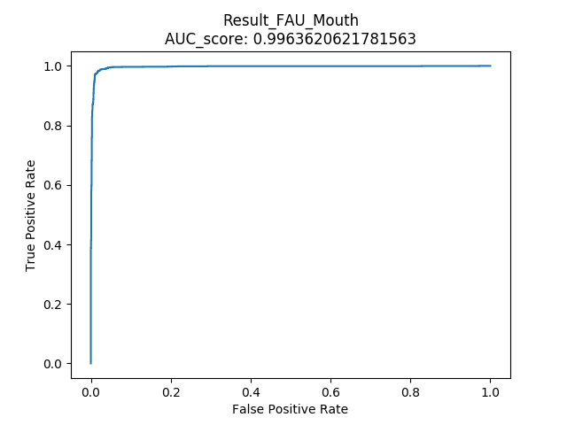
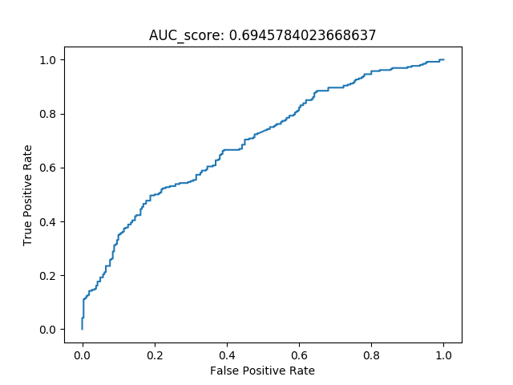
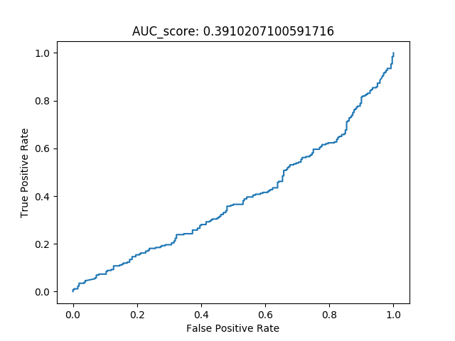
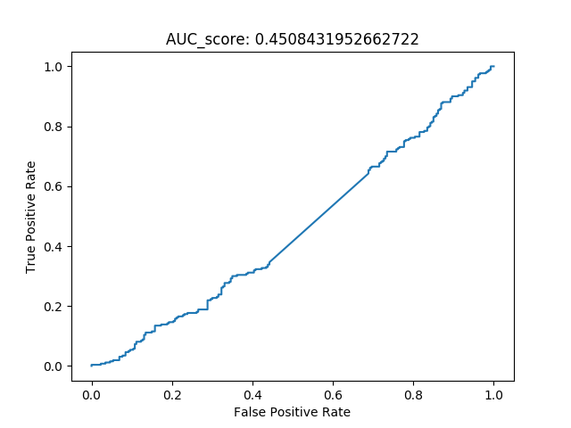
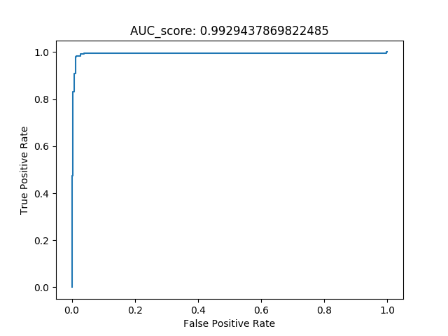
TP Sequence = 100 Frame, Overlap = 10 Frame
Brow FAU | Eyes FAU | Nose FAU | Mouth FAU
Obama
Trump

Slide 5
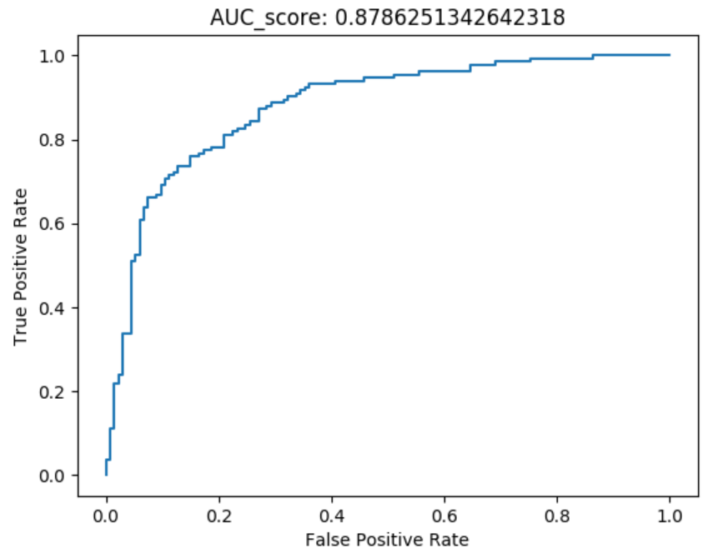
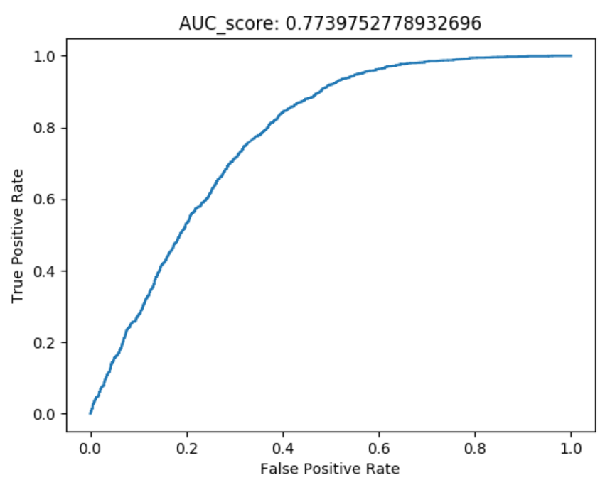
FaceSwap Fake Videos for Obama | Obama Imposter | Other Politicians
Lips
FaceSwap Fake Videos for Trump | Other Politicians
Lips

Slide 6
FaceSwap Fake Videos for Trump | Other Politicians
Lips

Slide 7
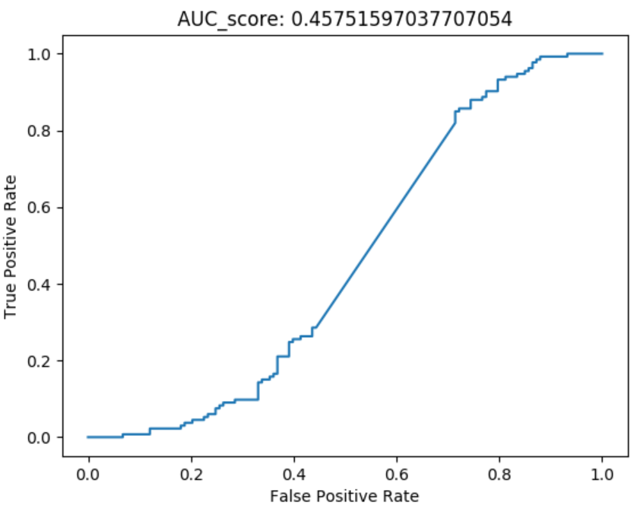
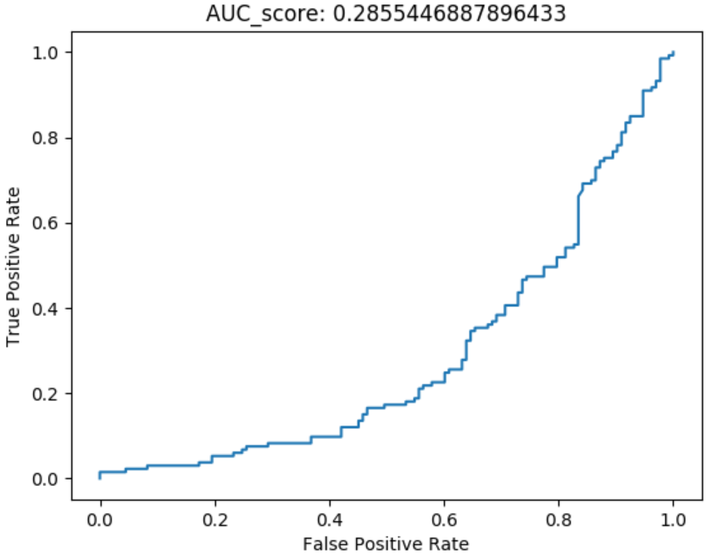
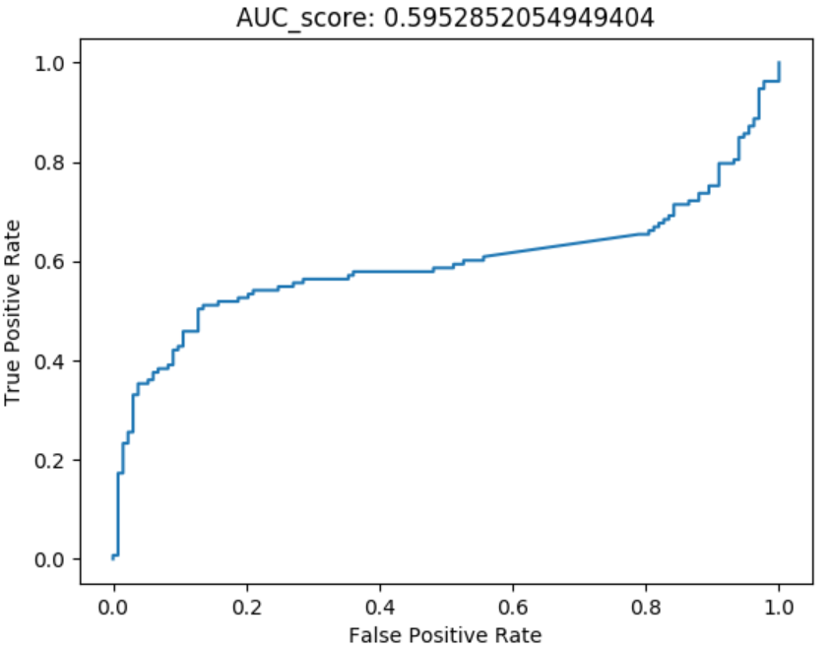
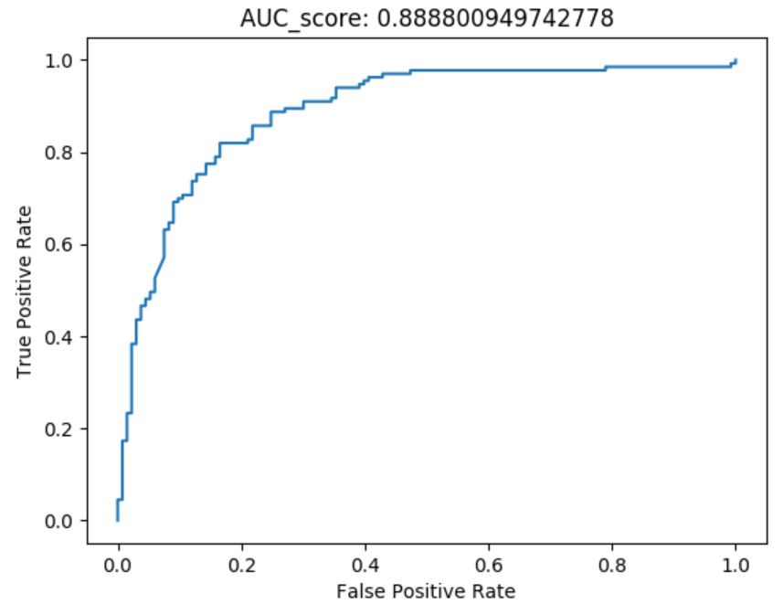
Sequence = 100 Frame, Overlap = 10 Frame Test Negative: Generated face-swap fake videos for Obama vs. Obama Imposter
Test Negative
FaceSwap Fake Videos for Obama
Obama Imposter
Head wrt. Camera | Head Rotation | Gaze | Blink | Lips

Slide 8
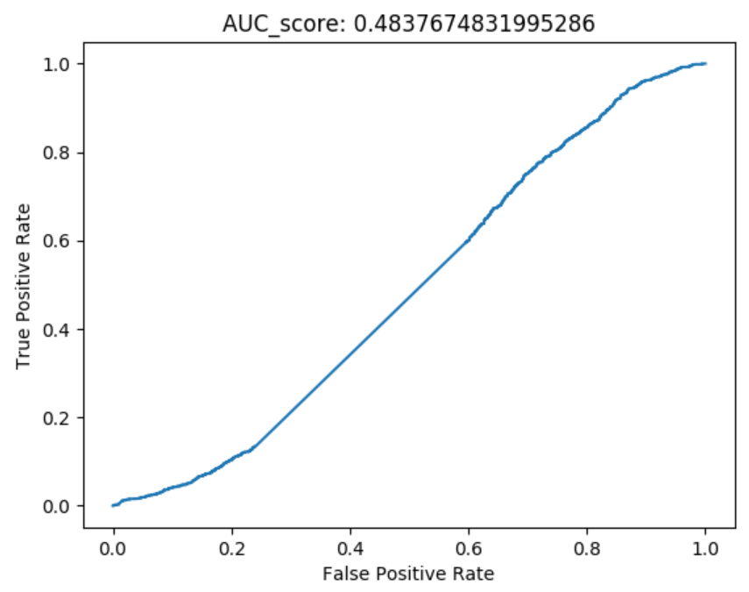
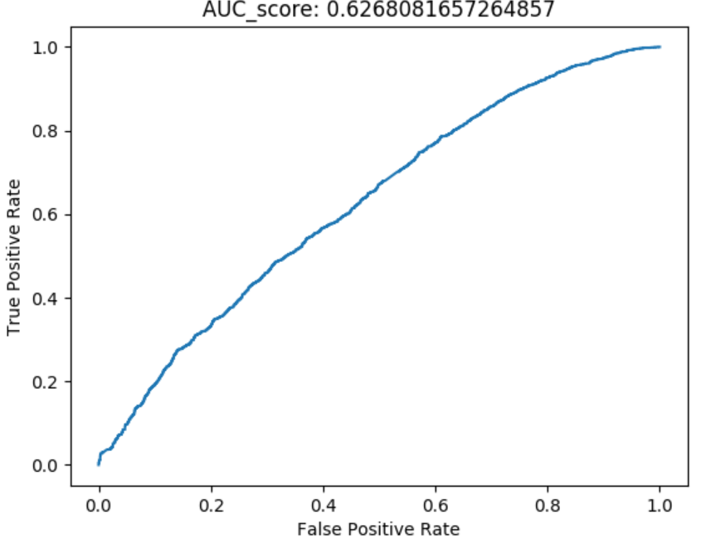
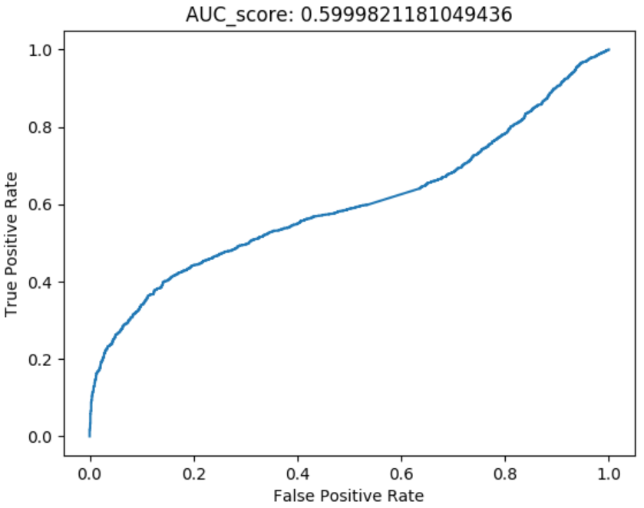

Sequence = 100 Frame, Overlap = 10 Frame Test Negative: Generated face-swap fake videos for Obama vs. Other Politicians
Test Negative
FaceSwap Fake Videos for Obama
Head wrt. Camera | Head Rotation | Gaze | Blink | Lips

Slide 9
Sequence = 100 Frame, Overlap = 10 Frame Test Negative: Generated face-swap fake videos for Trump vs. Other Politicians
Test Negative
FaceSwap Fake Videos for Trump
Other Politicians
Head wrt. Camera | Head Rotation | Gaze | Blink | Lips

Slide 10
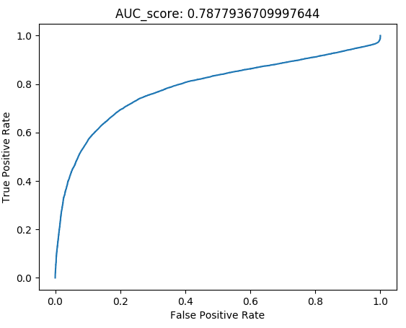
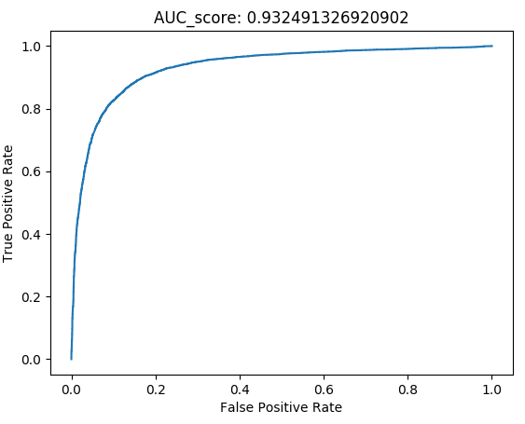
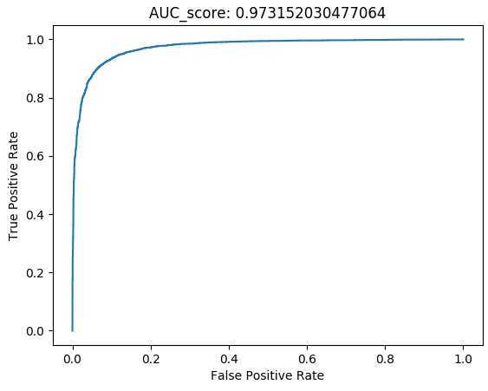
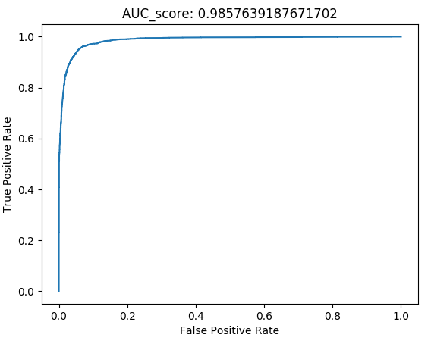
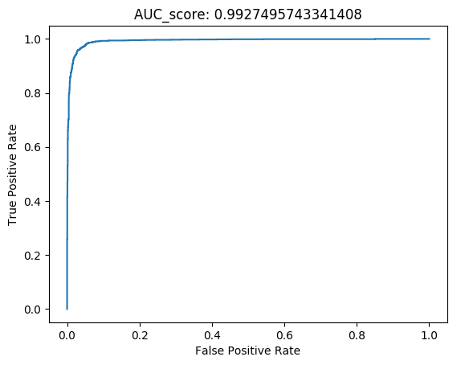
Frames | 10 | 30 | 50
Overlap | 1 | 3 | 5
Frames | 70 | 100 | 110
Overlap | 7 | 10 | 30

Slide 11
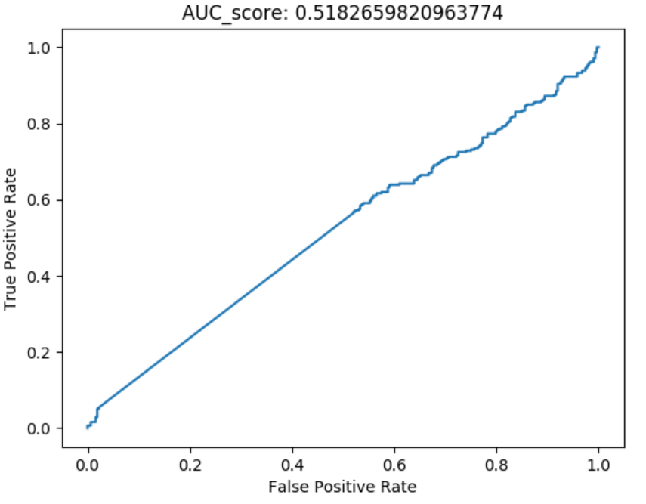
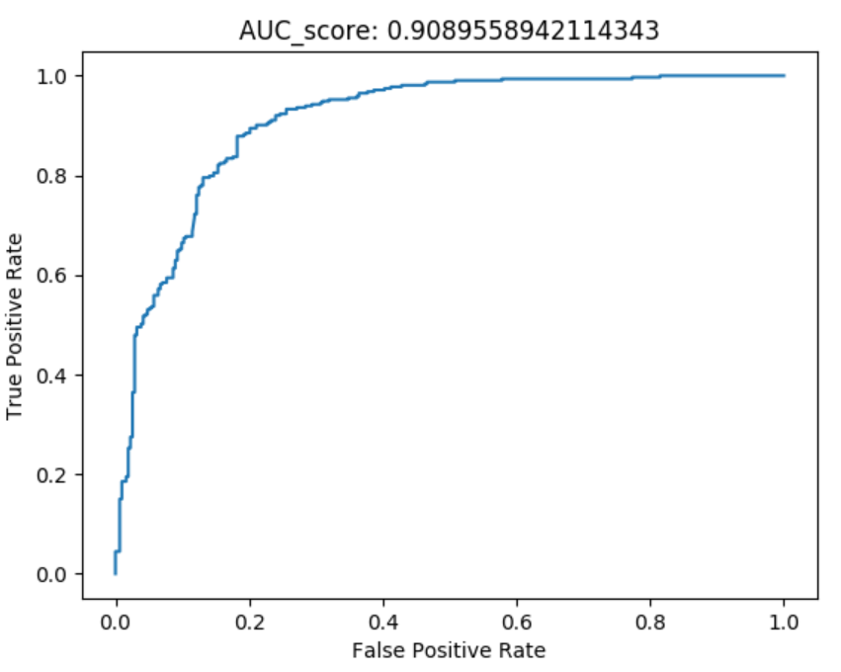
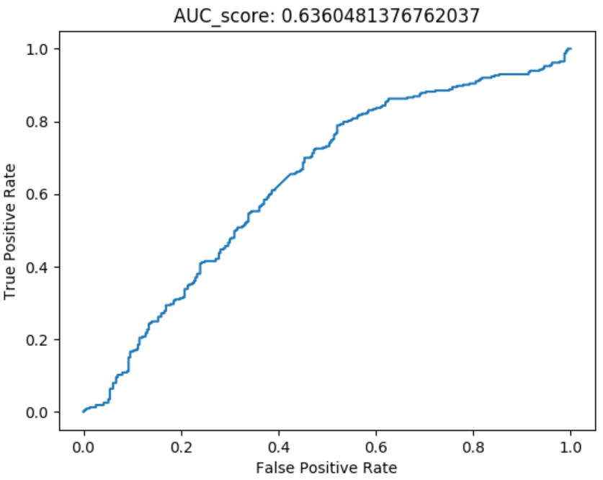
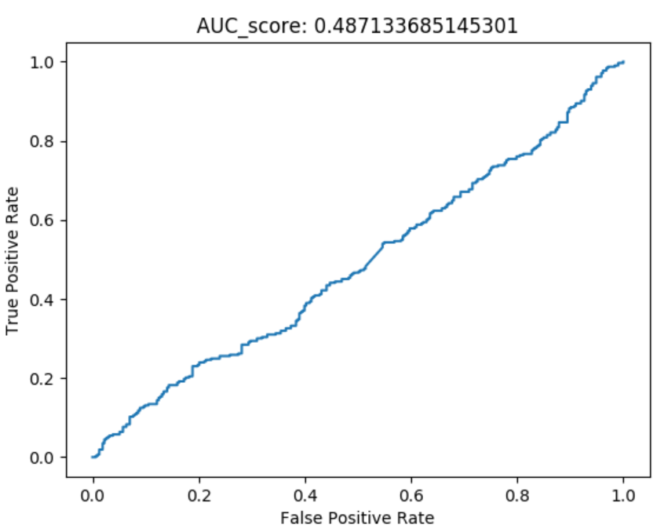
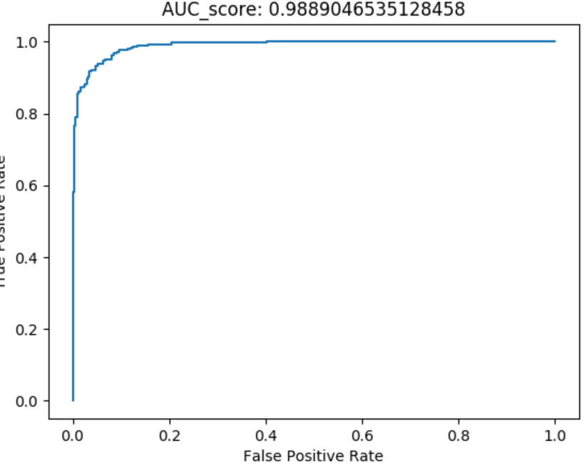
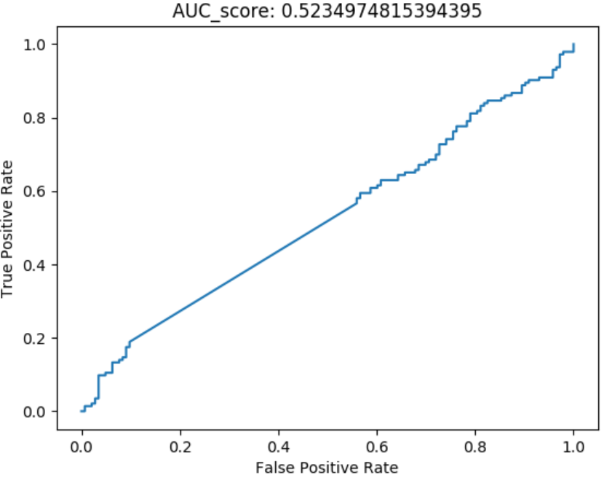
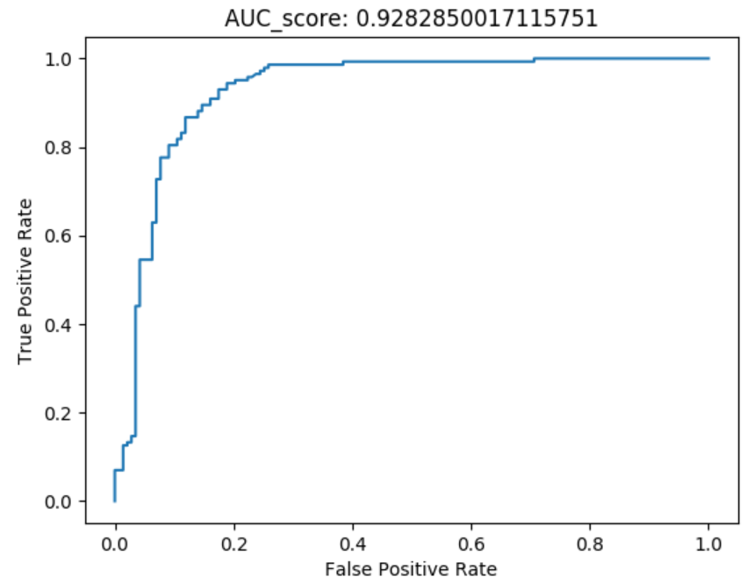
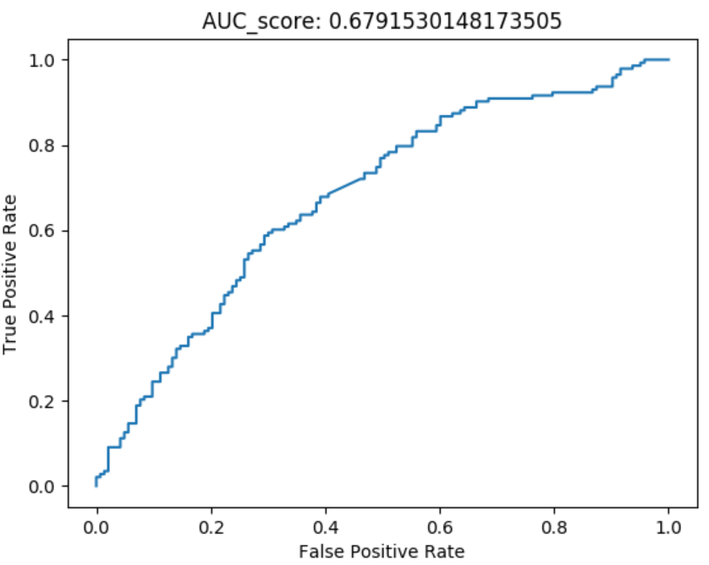
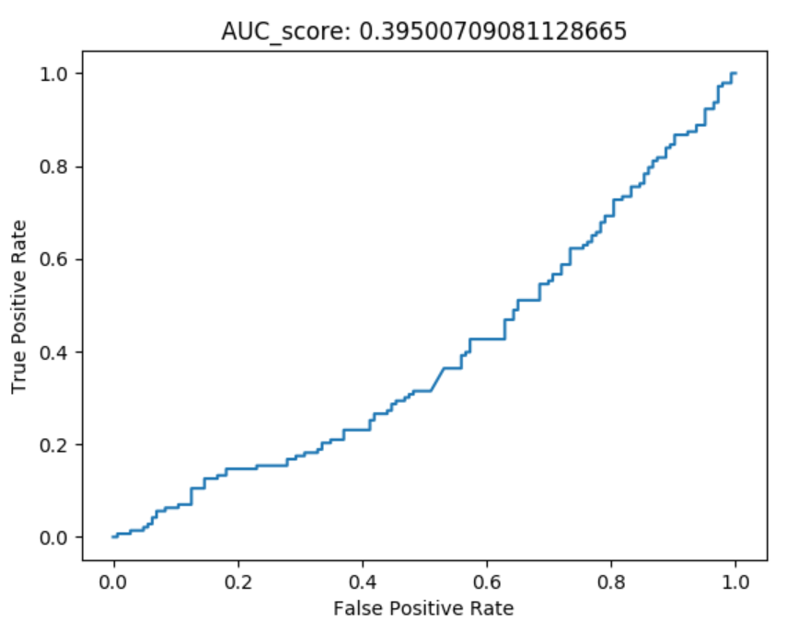
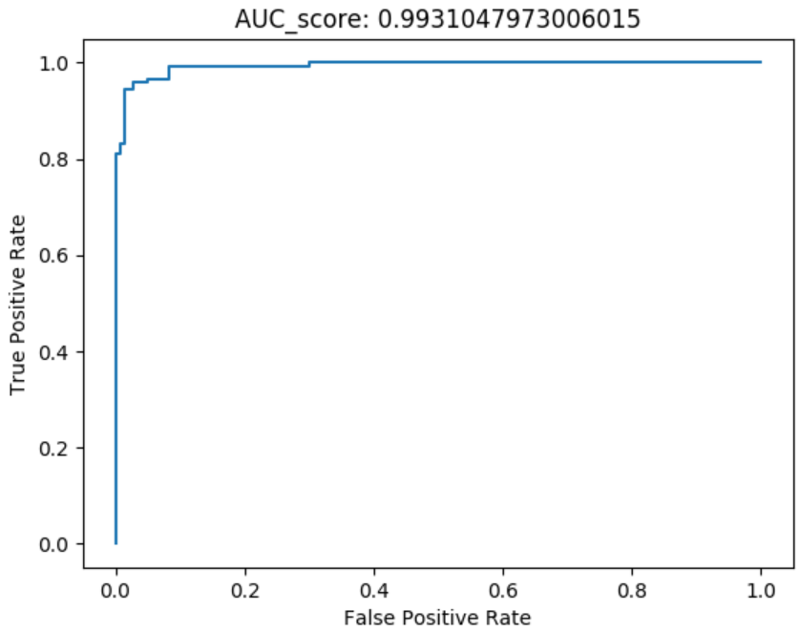
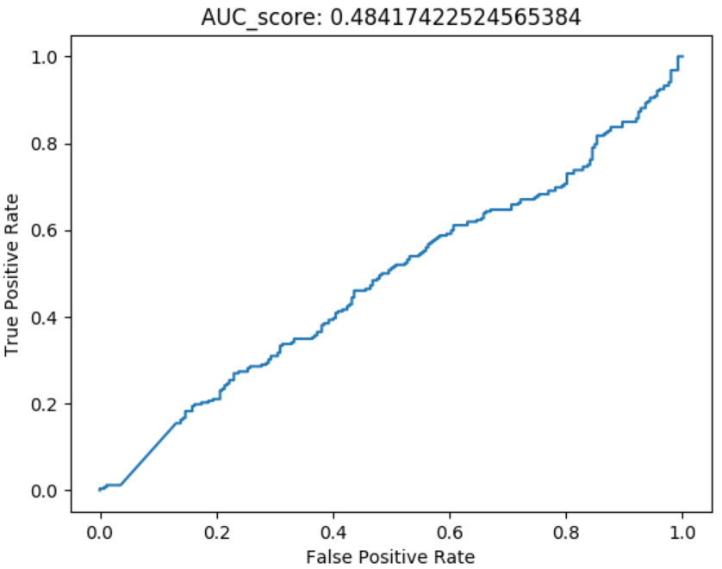
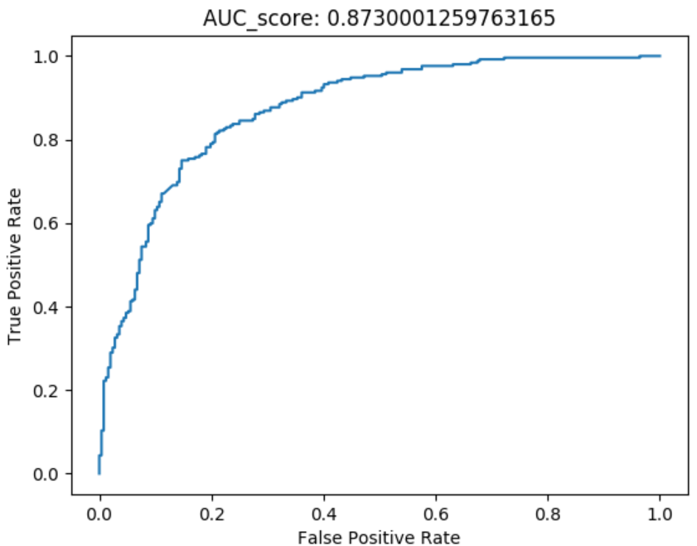
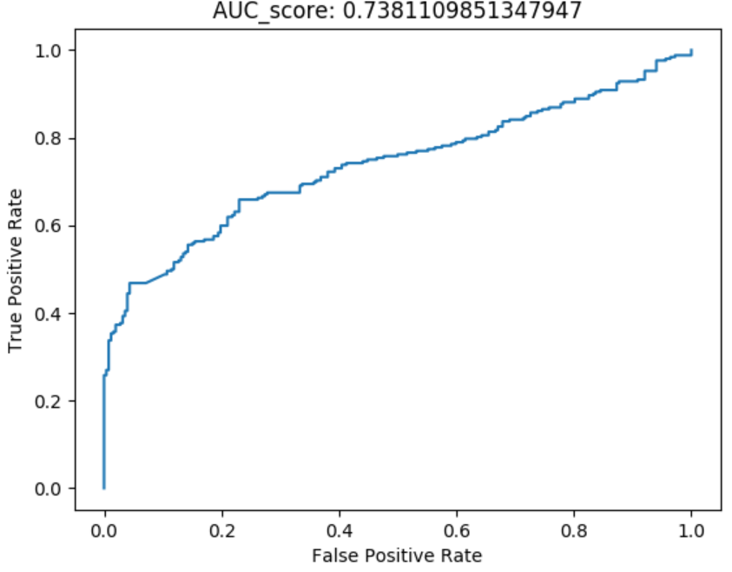
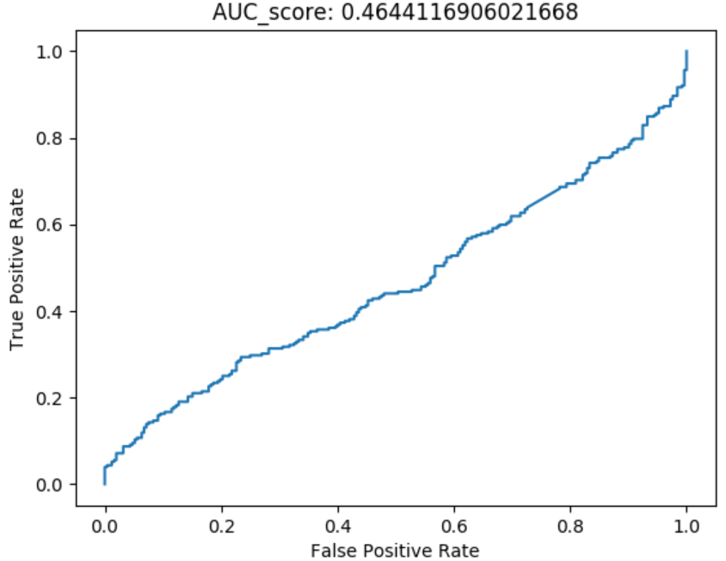
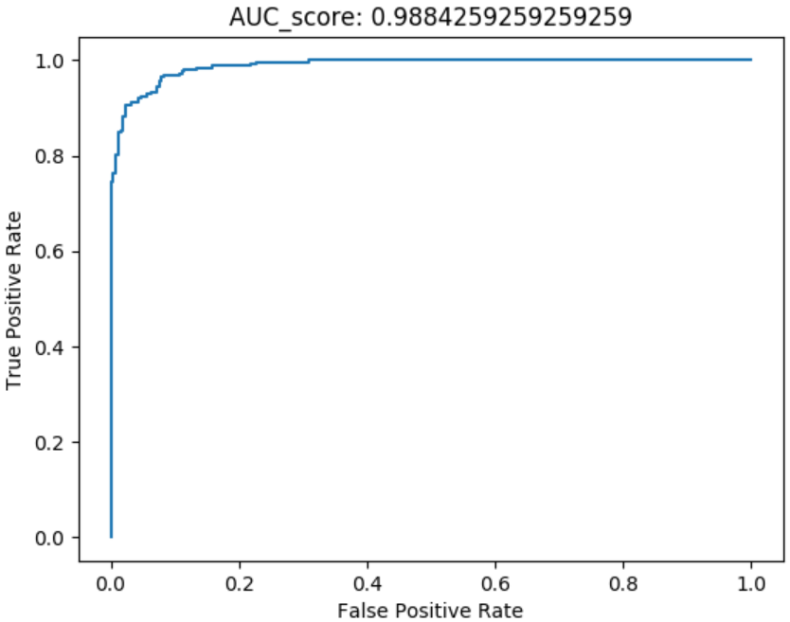
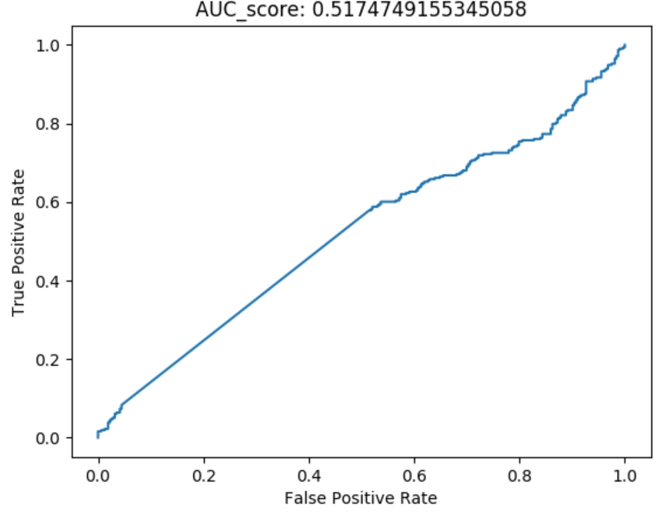
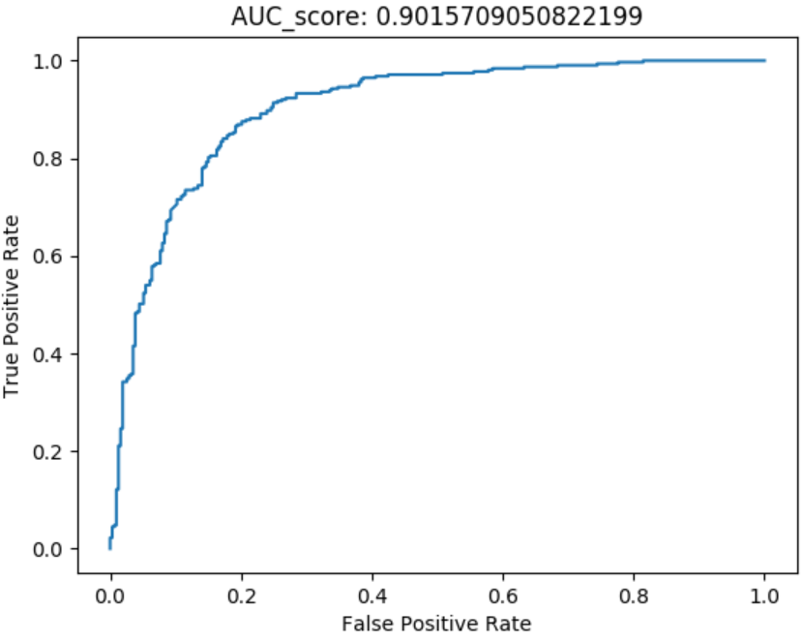
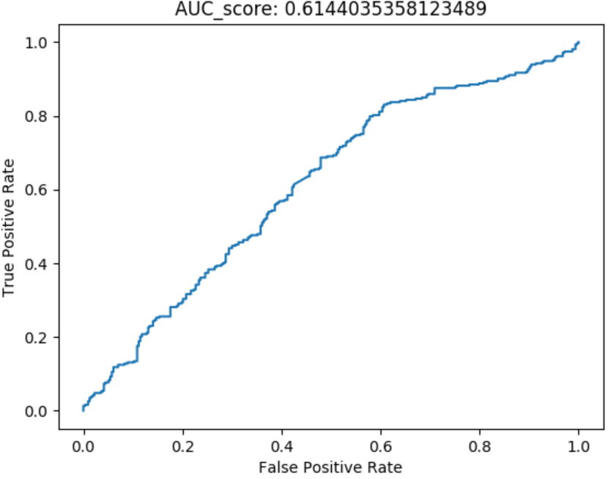
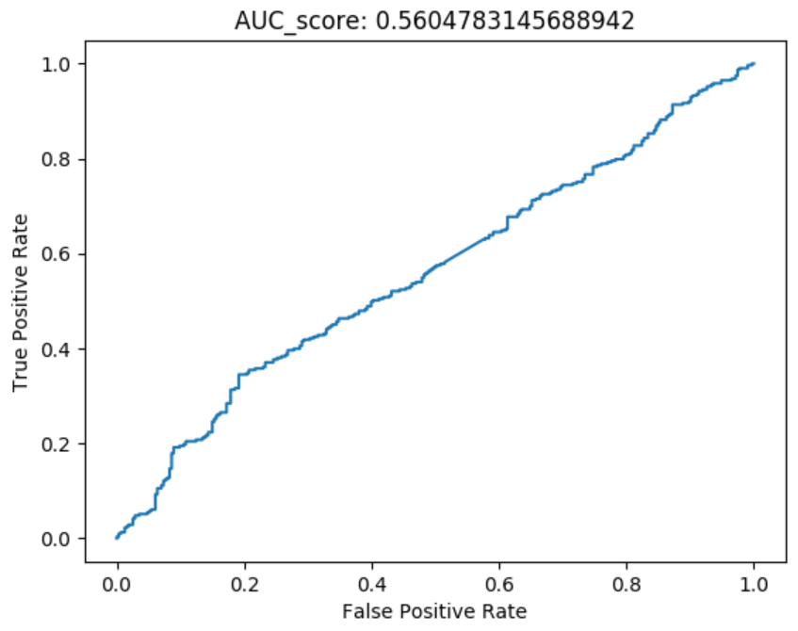

Head wrt. Camera | Head Rotation | Gaze | Blink | Lips
Uncompressed FaceSwap Fake Videos for Obama
Compressed FaceSwap Fake Videos for Obama Bitrate = 300Kbps
Compressed FaceSwap Fake Video for Obama ½ Frame Rate
Compressed FaceSwap Fake Video for Obama ½ Frame size
Compressed FaceSwap Fake Video for Obama Color Reduction

Slide 12
Image Quality Analysis Sequence = 100 Frame, Overlap = 10 Frame Test Positive: real Obama videos vs. Compressed real videos Test Negative: Generated fake videos with Obama mask vs. Compressed Fake Video Compression Method: Bitrate reduced to 300kps
Head wrt. Camera | Head Rotation | Gaze | Blink | Lips
FaceSwap Fake Videos for Obama
Compressed Fake Video for Obama Bitrate = 300Kbps

Slide 13
Head wrt. Camera | Head Rotation | Gaze | Blink | Lips
FaceSwap Fake Videos for Obama
Compressed Fake Video for Obama ½ Frame Rate

Slide 14
Image Quality Analysis Sequence = 100 Frame, Overlap = 10 Frame Test Positive: real Obama videos vs. Compressed real videos Test Negative: Generated fake videos with Obama mask vs. Compressed Fake Video Compression Method: Frame size reduced to ½ of original
Head wrt. Camera | Head Rotation | Gaze | Blink | Lips
FaceSwap Fake Videos for Obama
Compressed Fake Video for Obama ½ Frame size

Slide 15
Image Quality Analysis Sequence = 100 Frame, Overlap = 10 Frame Test Positive: real Obama videos vs. Compressed real videos Test Negative: Generated fake videos with Obama mask vs. Compressed Fake Video Compression Method: Color reduction
Head wrt. Camera | Head Rotation | Gaze | Blink | Lips
FaceSwap Fake Videos for Obama
Compressed Fake Video for Obama Color Reduction

Slide 16
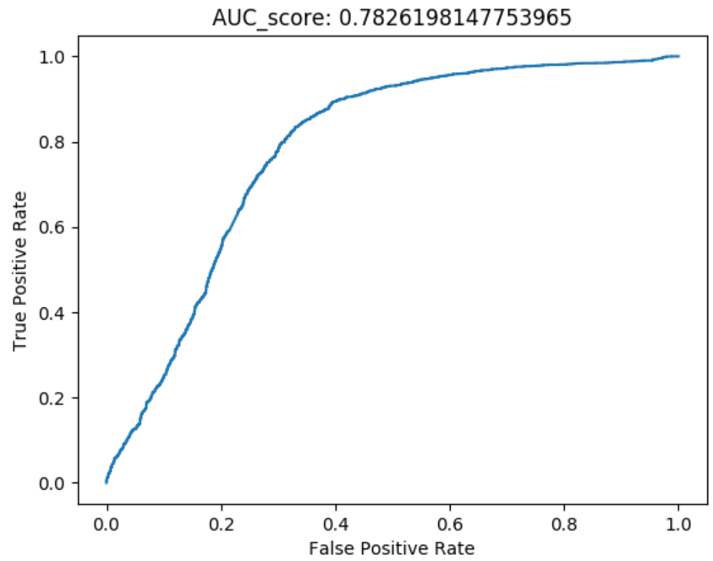


Feature Analysis Sequence = 100 Frame, Overlap = 10 Frame Test Negative: Generated fake videos with Obama mask vs. Other Politician(Hillary)
Gaze | Blink | Lips
Train with Face Forensic dataset
Train with Politician dataset (May, Pompeo, Officials)

